Slide 1

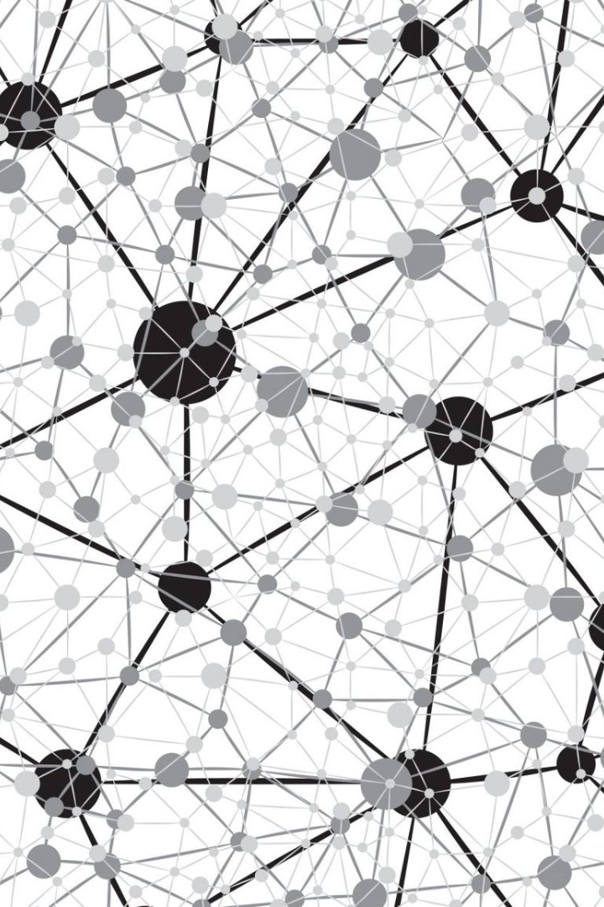
NLP Networks Recurrent Neural Networks (RNNs)
Recurrent Neural Networks (RNNs) are a powerful subset of machine learning algorithms that allow for the processing of sequential data by introducing feedback loops into the network architecture.

Slide 2

Vanishing and Exploding Gradient Problem
1
Vanishing Gradient:
2
Exploding Gradient:
When the gradient becomes too small, the network may become unable to learn.
When the gradient becomes too large, the network may become unstable and fail to converge.
3
Solutions:
Techniques such as weight initialization, gradient clipping, and careful network architecture design can mitigate these issues.

Slide 3
Backpropagation Through Time (BPTT)
1
Forward Pass:
The input is fed through the network, producing an output.
2
Loss Calculation:
The output is compared to the target and a loss function is calculated.
3
Backward Pass:
The derivatives of the loss are propagated backwards through the network using the chain rule.

Slide 4
Applications of RNNs in NLP
Language Modeling:
Machine Translation:
Predicting the likelihood of the next word in a sequence.
Translating text from one language to another.
Named Entity Recognition:
Sentiment Analysis:
Identifying named entities such as people, places, and organizations in text.
Determining the sentiment expressed in a piece of text.

Slide 5

Challenges and Limitations
1
Capturing Long-Term Dependencies:
2
Training on Large Datasets:
Vanishing gradients can make it difficult for RNNs to capture long-term dependencies.
RNNs require large amounts of data to train effectively, which can be time-consuming and resource-intensive.
3
Generalization:
RNNs may struggle to generalize to new examples outside of the training data distribution.

Slide 6
Improving RNNs: LSTMs and GRUs
Long Short-Term Memory (LSTM)
Gated Recurrent Unit (GRU)
GRUs simplify the LSTM architecture while still incorporating gating mechanisms to selectively update or pass on information.
LSTMs use a memory cell that can selectively forget or store information, allowing them to capture longer-term dependencies.

Slide 7


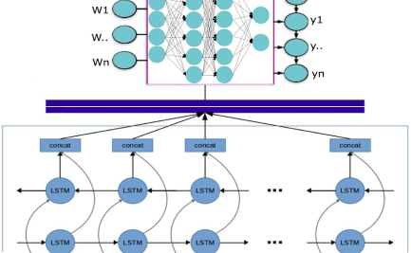
Bidirectional RNNs
Forward RNN:
Backward RNN:
Concatenation:
The input is processed sequentially from start to finish.
The input is processed sequentially from end to start.
The outputs of the forward and backward RNNs are concatenated to form the final output.

Slide 8

Deep RNNs and Stacking Layers
1
Stacking Layers:
2
Deep RNNs:
Multiple RNN layers can be stacked to create a deeper network.
Deep RNNs can capture more complex relationships in the data and improve performance.
3
Computational Cost:
Deeper networks may require more computational resources, making them more difficult to train.

Slide 9
Sequence-to-Sequence Learning
Encoder:
Decoder:
The input sequence is encoded into a fixed-length representation.
The output sequence is generated based on the encoded representation and optionally, previous outputs.

Slide 10
Attention Mechanisms
1
Global Attention:
The decoder attends to the entire input sequence at each time step.
2
Local Attention:
The decoder attends to a specific section of the input sequence at each time step.
3
Self-Attention:
An attention mechanism where input is compared to itself to compute attention weights.

Slide 11
Future Directions in RNNs
Memory Augmented Neural Networks:
Continual Learning:
The ability of a model to learn new tasks without forgetting previously learned ones.
Integrating external memory into neural networks to improve their capacity.
Interpretability:
Hybrid Models:
Improving our understanding of the internal workings of neural networks.
Combining RNNs with other machine learning architectures for improved performance.

Slide 12

Conclusion
Recurrent Neural Networks are a versatile and powerful tool for natural language processing tasks. By understanding the underlying architecture and techniques for improving performance, we can solve increasingly complex problems and continue to push the boundaries of what is possible.

